Slide 1
Project Proposal: Spider Detector
Dominik Szewczyk
224180

Slide 2
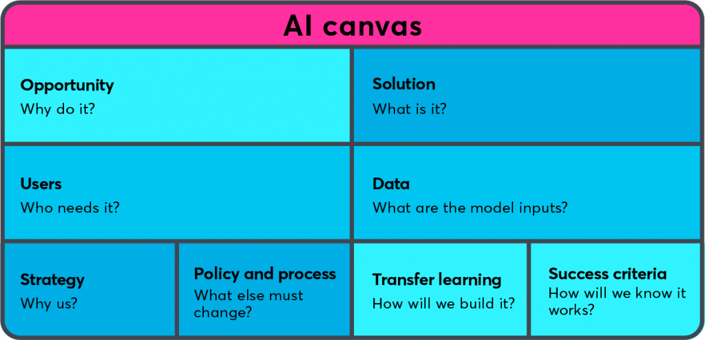
AI Canvas: provide high-level overview
Australia is a popular destination for tourists.
Application able to identify spiders and assess level of danger to humans
Tourists visiting Australia.
Images of spider
CNN Machine learning model
Accurate model/ User-friendly app prototype
SKIP THIS PART
DISRUPTIVE TECH RISKS

Slide 3
Conduct market research & target audience analysis
More and more people visit Australia every year. This beautiful country has a lot amazing places, but we can also come across threats, especially for tourists. Spiders are one of them. An application that allows you to detect spiders, show the level of threat and some of the most important information would certainly make life easier for users because with such an application they could feel safer. Thanks to that they would be able to explore Australia with more pleasure. The app should also reduce the number of people bitten by poisonous spiders. Tourists often have no idea what spider they are dealing with, the application would help them learn more about it and also reduce the danger of being attacked. Applications available on the market are able to provide information about the spider, but they do not inform about the scale of the threat and what we should do next. The applications that we have on the market now may work well in a zoo or a pet store, but not in a natural environment.

Slide 4
Argue for proposal feasibility
The application will use image recognition technology to identify spiders based on a photo but will also have a live camera option. The app will use artificial intelligence and machine learning algorithms to identify the spider. The application will then provide information about the spider, including its habitat, behaviour, and level of danger to humans. The application will also include a threat level system that ranks spiders on a scale from low to high based on the level of danger to humans. The application will be designed to be user-friendly and easy to navigate, with a clean and modern interface that allows users to quickly access the information they need.

Slide 5
Market Segmentation
Families planning to go to Australia:
Age: 25-45 years old
Income: Middle to high income bracket
Education: High school to postgraduate level
Family size: Two or more people, including children
Geographic location: Nationwide or regional areas with potential spider presence
Behavorial: Safety-conscious, interested in outdoor activities and wildlife encounters, likely to seek professional help for spider-related issues
2.Photographers planning to go to Australia:
Age: 18-45 years old
Income: Variable, has savings.
Education: High school to postgraduate level
Geographic location: Nationwide or international
Behavorial: Adventurous, interested in nature and wildlife photography, willing to take risks for the perfect shot, likely to invest in high-quality equipment and resources for spider detection and photography

Slide 6
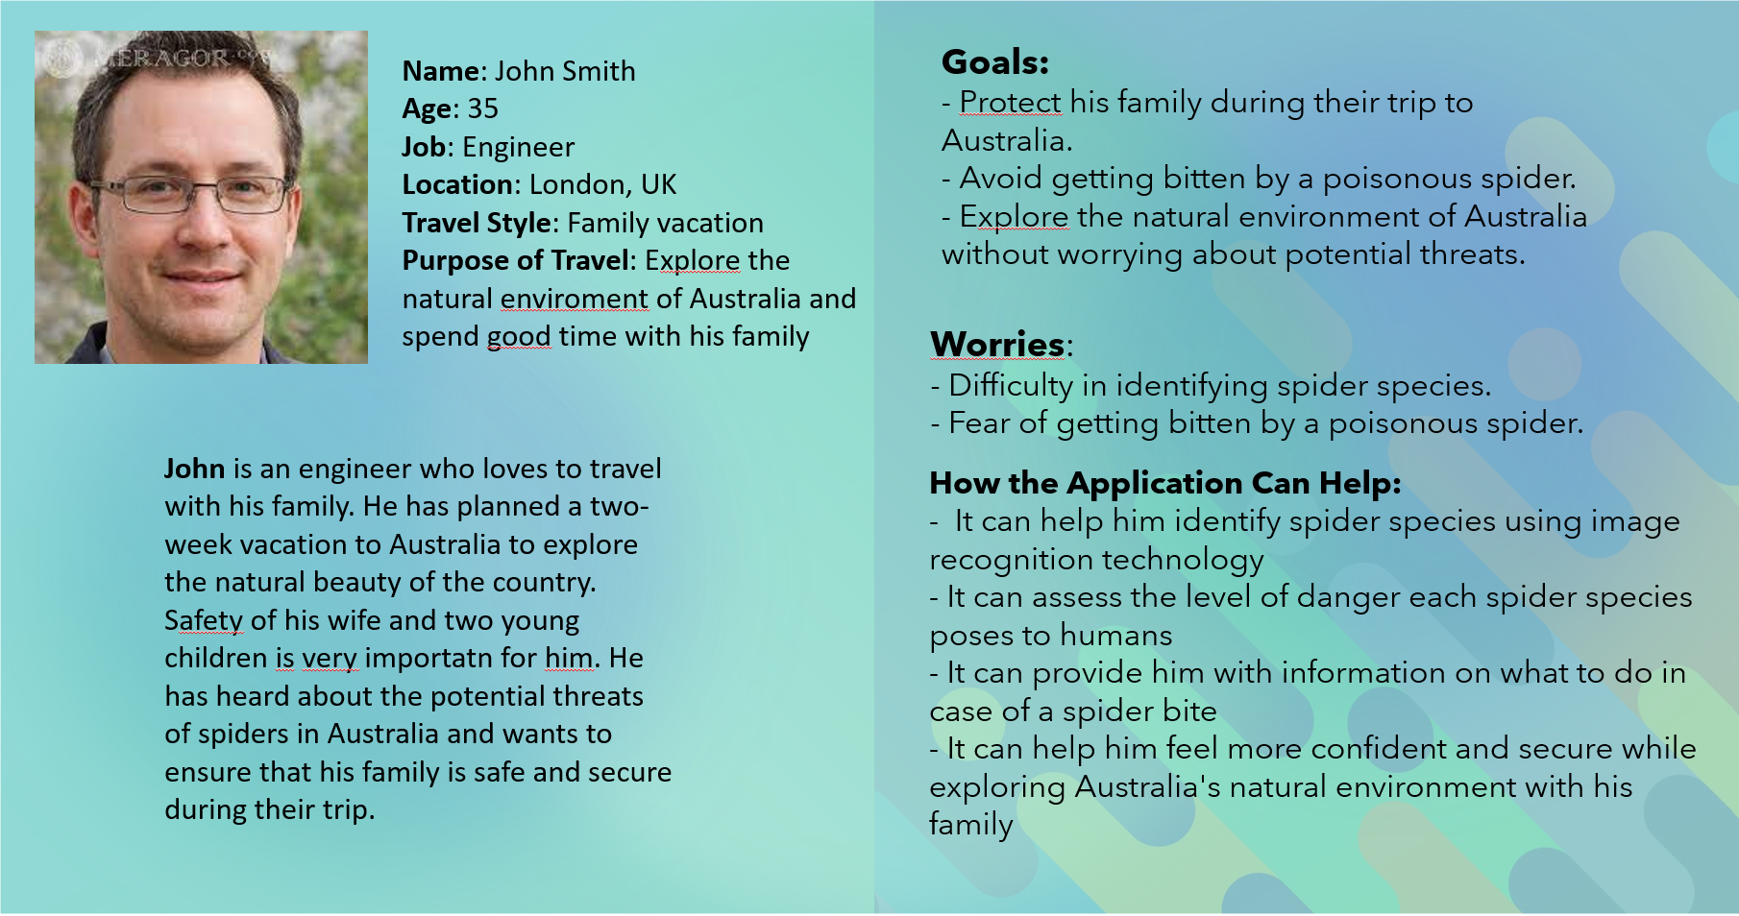
User Persona
The application should ensure the safety of John and his family. It should allow him to identify spider species using image recognition technology. What is more, it should assess the level of danger when John scans a spider and provide information about it. With the application, tourists should feel safe while exploring Australia.

Slide 7
Bias in Imsitu dataset
When I was reviewing the data, I observed examples of bias:
Firstly, I focused on racism, and it wasn’t so hard to find out that most of the pictures with black people have the title “mining”. We can clearly see pictures of black people, sometimes also children, which are working without any tools, In horrible conditions. Thats strange that there is that much bias to black people among this date, and for sure it shouldn't look like that.
What is more, I checked all photos with weddings and unfortunately there is another example of bias. All of wedding couples are heterosexual. There we have clear example of bias against homosexuality.
Biases are a big threat these days and we should do everything we can to prevent them. People who are victims of bias could have real problems because of discrimination. Especially teenagers are at risk because it is more difficult for them to deal with bias.
Nowadays more and more companies remember about it and they wouldn't like to cooperate with biased applications. So is important to check our data before creating the model because biased data prevents us from starting the project.

Slide 8
How to mitigate bias in the Imsitu dataset?
When I was analysing data, I focused on 2 examples of bias, so I will show two ideas on how to mitigate bias in the Imsitu dataset.
First sensitive/protected attribute which I identified is skin colour in groups of people working in mines. We should use Fairness Through Unawareness method to remove pictures of black people who are forced to mine in terrible conditions. This method will mitigate bias in the Imsitu dataset because racist images will be removed, stopping their use and future distribution.
Second, identified sensitive/protected attribute is gender of the married couple. In this case, we should use Fairness Through Awareness method by adding photos of homosexual couples. This will be fair, and will definitely help mitigate bias in the Imsitu dataset because balance will be maintained.

Slide 9
Proof-of-Concept: Deep Learning
The dataset
Baselines
Preprocessing
CNN architecture
CNN training
Model performance
Error analysis
Iteration

Slide 10
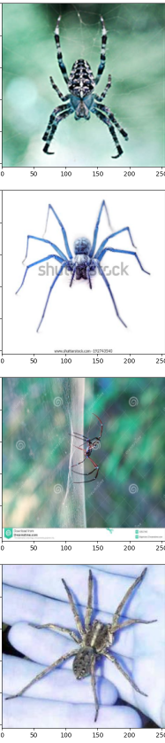
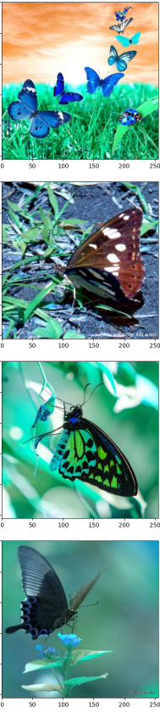
PoC: The dataset
I have binary classification problem because I have 2 classes.
Images of Butterflies: 203 Images of Spiders: 188
Train dataset sizes: 316 Test dataset size: 39 Validation Dataset size: 40
Image size: 256 x 256
Images are labeled according to their file names. If the file name contains the word "spider", the label for the image is set to 1, otherwise it is set to 0.
I import some images form Imsitu dataset, and I scraped some data using: duckduckgo_search
Example of Spiders: Example of Butterflies:

Slide 11
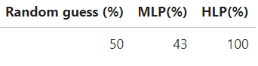
PoC: Baselines
Random guess accuracy is 50%
Human-Level Performance accuracy is 100%
Multilayer Perceptron accuracy is 43%

Slide 12
PoC: Preprocessing
Resizing the images to size of 256x256
Normalization

Slide 13
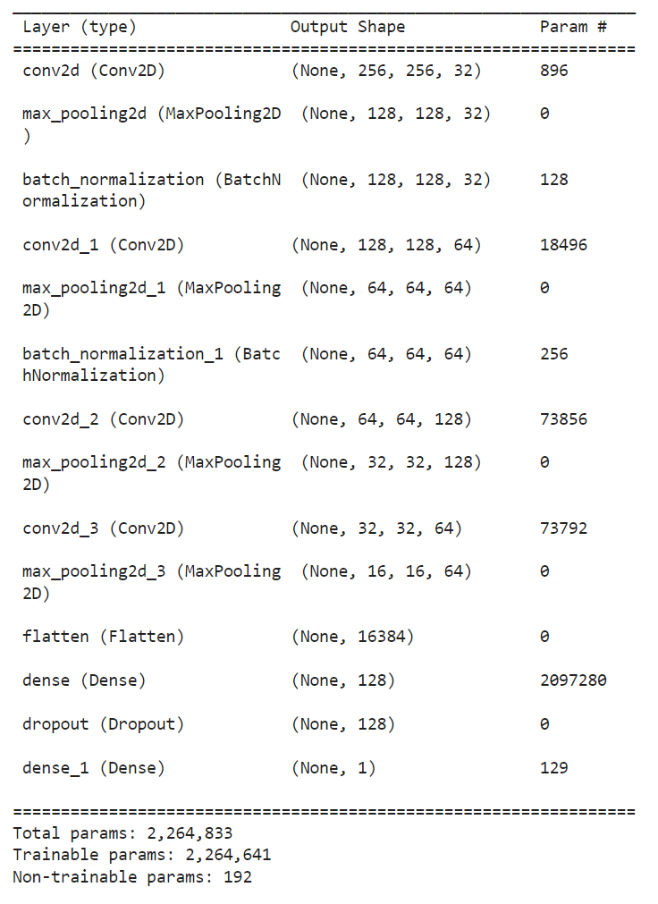
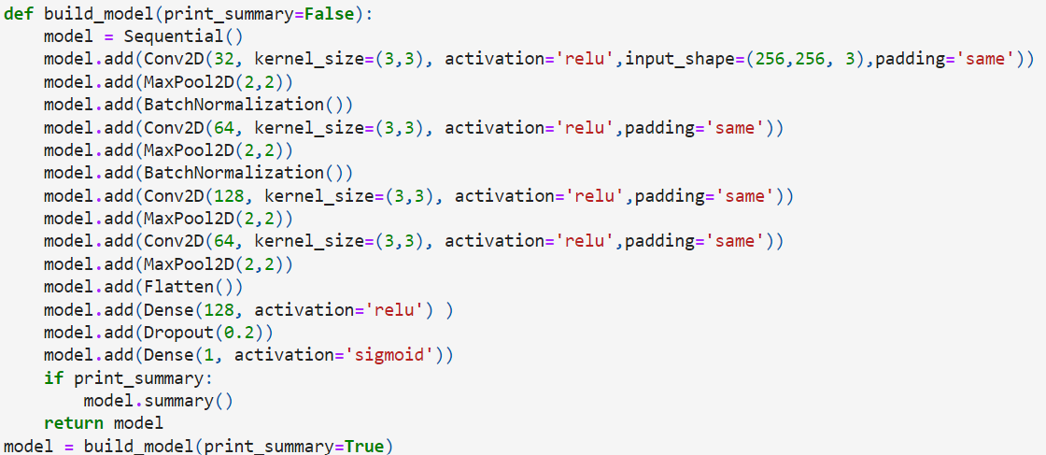
PoC: CNN architecture

Slide 14
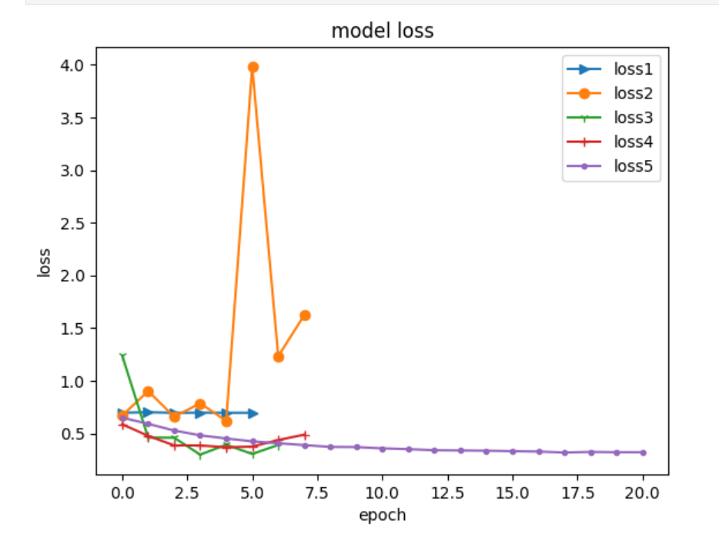
PoC: CNN training
I used binary_crossentropy loss function because it is the best function for binary classification problem
I used Adam optimizer and 0,00001 learning rate because as we can see on the plot, the model performed the best with this case.
I used metric accuracy because accuracy of my model was important for me.

Slide 15
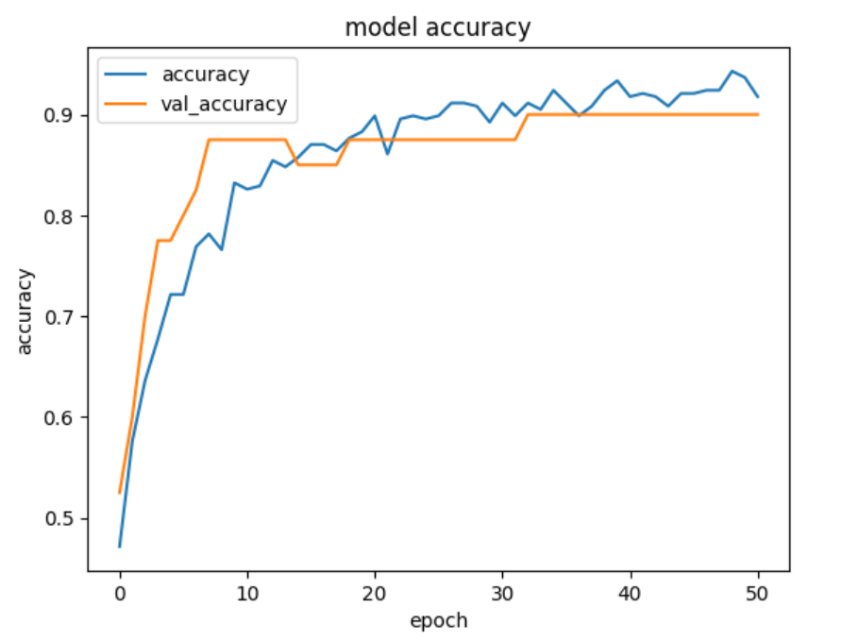
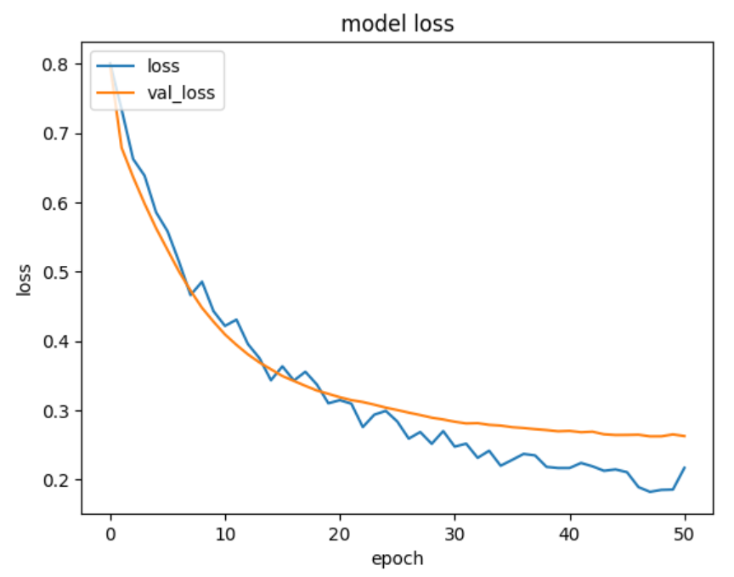
PoC: CNN training
On learning curves, we can see that my model works correctly. I used Early Stopping to prevent overfitting.

Slide 16
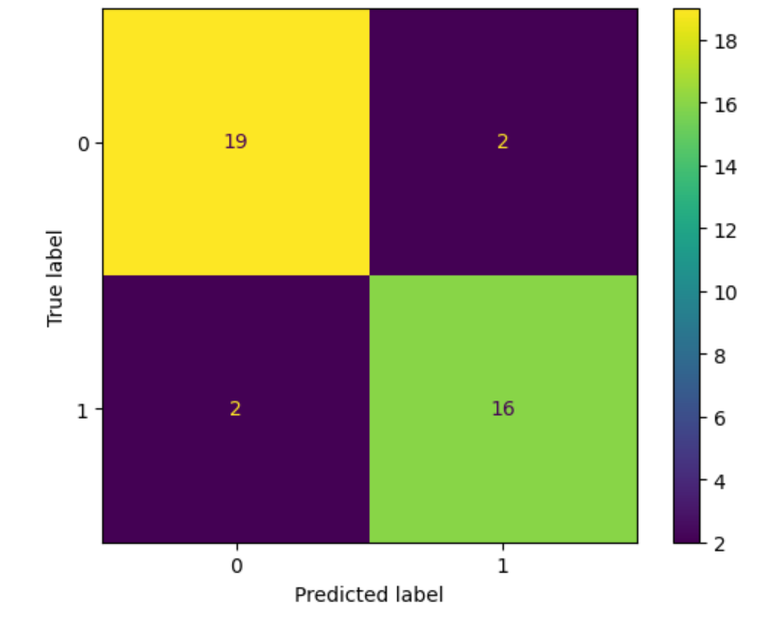
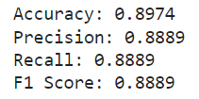
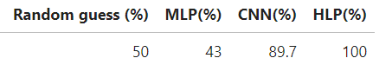
PoC: Model performance
Accuracy of my model on test dataset is 89%.
On the confusion matrix we can see that model misclassified 2 images with spider and 2 images with butterflies.

Slide 17
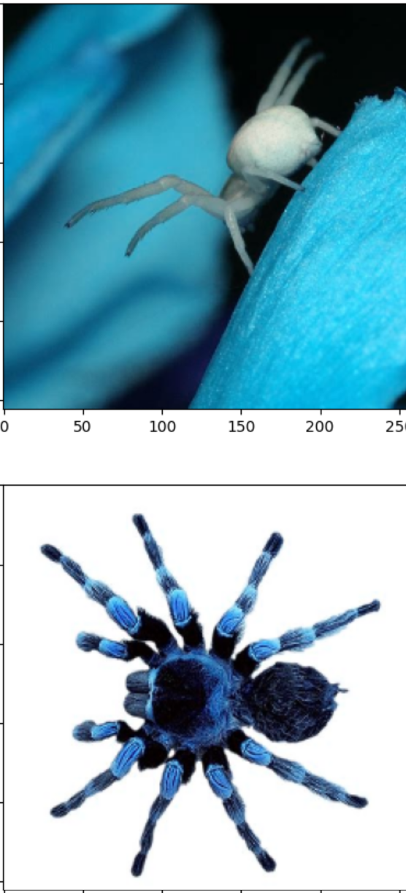
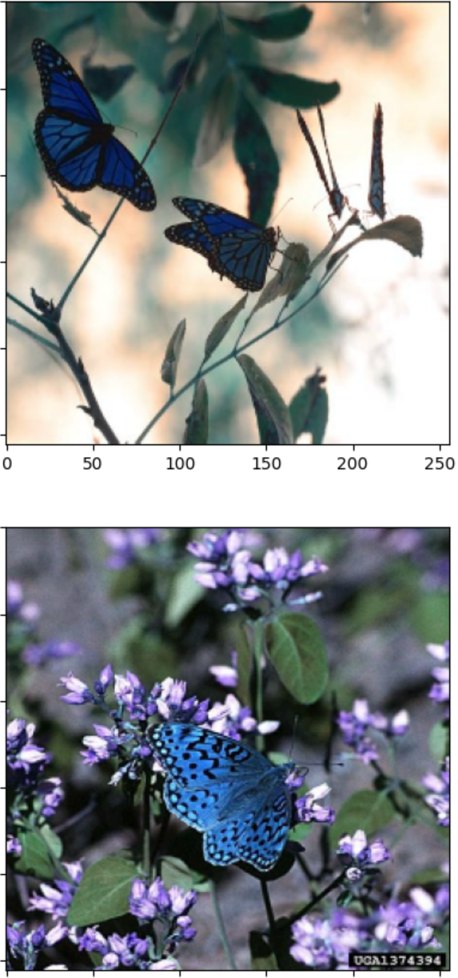
PoC: Error analysis
The model identified the spiders as butterflies due to similar color patterns and failed to recognize them accurately based on other visual features.
The model didn't recognize the butterflies because of the background noise

Slide 18
PoC: Iteration
In the first iteration, I used a basic Convolutional Neural Network (CNN) with 4 convolutional layers, 2 Batch Normalization layers, and a dense output layer. I trained this model on the dataset and evaluated it on the validation set. The results showed that the model was overfitting the training set, and had poor performance on the validation set.
In the next iteration, I added Maxpooling which helps me improve accuracy on the validation set but my model was still overfitting. That's why in the next iteration I added a dropout layer to the model to regularize it and reduce overfitting. It clearly helps and my model starts performing well.
During the error analysis, I noticed that in my data there are animated pictures of spiders that were bad for the accuracy of my model, so I decided to remove them so that the model could only learn from the right data

Slide 19
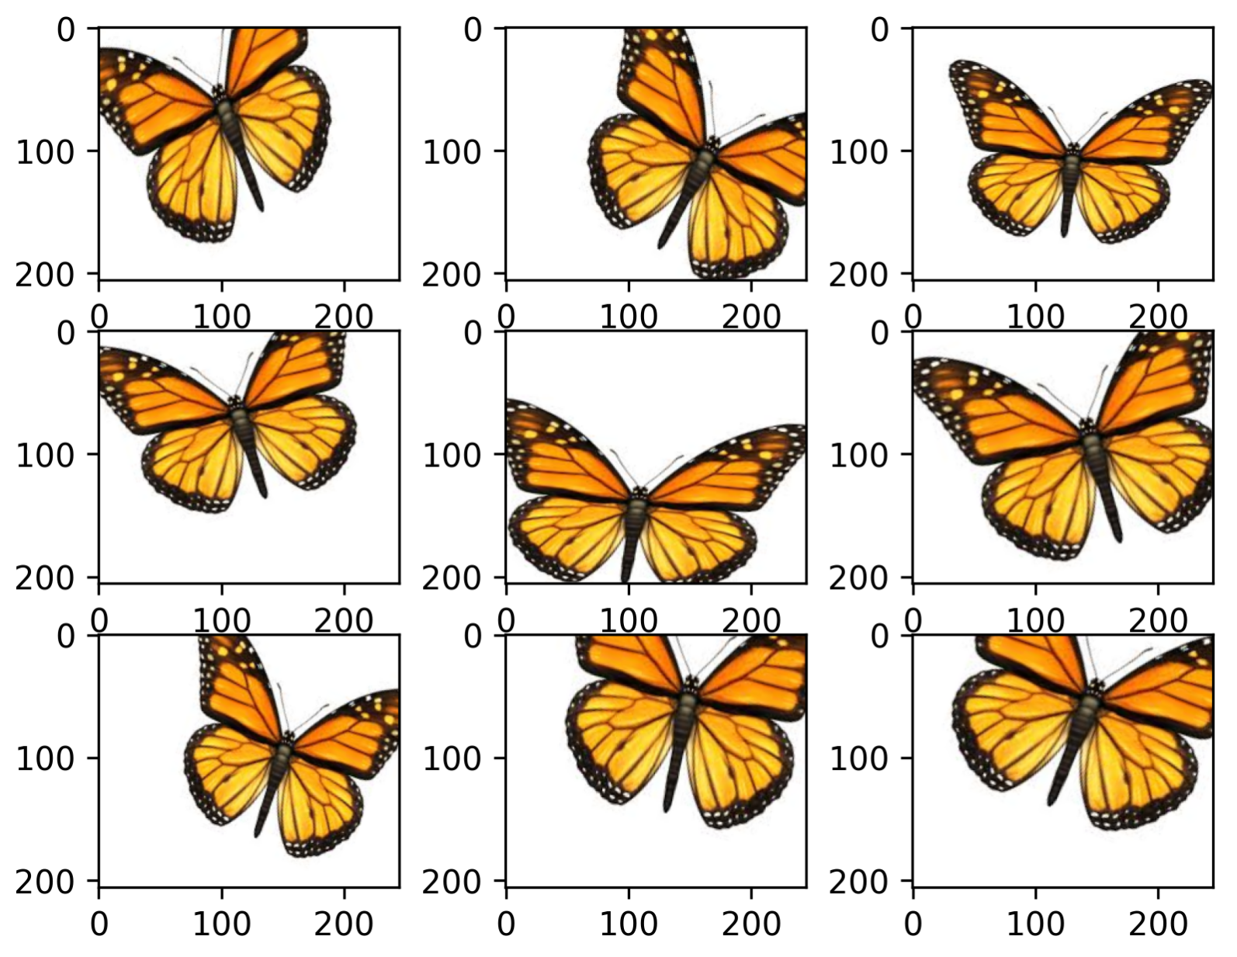
PoC: Iteration
During the error analysis, I noticed that in my data there are animated pictures of spiders that were bad for the accuracy of my model, so I decided to remove them so that the model could only learn from the right data
To increase the size of my image dataset, I applied data augmentation techniques.

Slide 20
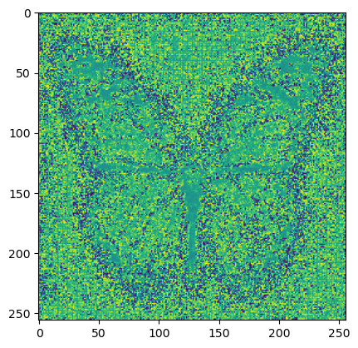
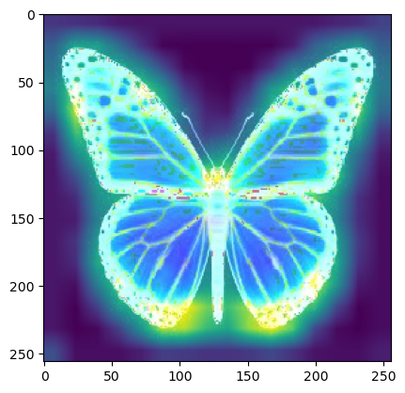
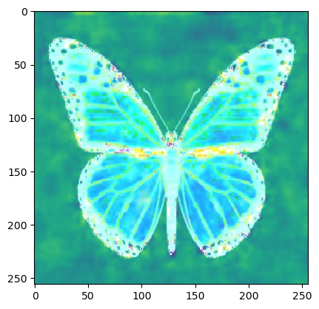
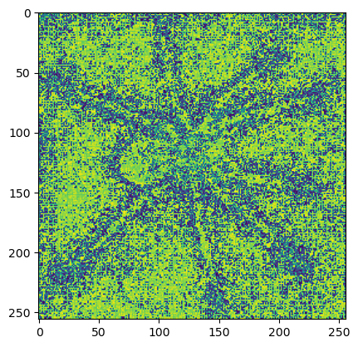
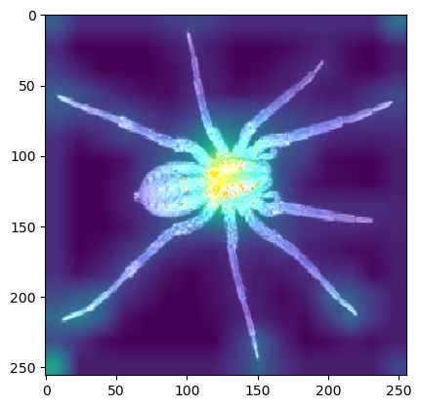
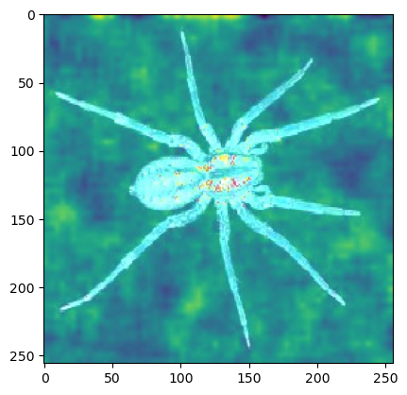
Responsible AI (Transparency & Interpretability)
Bias, fairness, transparency and interpretability
The model needs to be as accurate as possible because this is the most important in case of recognising dangerous spiders, but I also wanted make my model interpretable and transparent.
That's why I used different XAI methods and compared the results to be sure that my model works correctly.

Slide 21
Disruptive Technology Risks
Risks
Contingency Plan
Economic risks: Financial loss could result from an insufficient Disruptive Technology process, such as the failure to implement robust security measures to protect user data.
Operational risks: Incomplete or failed internal processes, including human resources and organizational dynamics, could lead to a breakdown in the application's functionality and accuracy.
Technology risks: The likelihood of failure due to technical and engineering issues, such as image recognition technology problems, could result in inaccurate spider identification and potentially harm users.
Quality risks: The risk of failing to deliver the desired level of quality demanded by the targeted market segment, such as providing inaccurate information about spiders or incorrect identification.
Economic Risks: To reduce financial risks, a budget should be allocated for the development of the spider detector application. The budget should include adequate funds to implement security measures to protect user data.
Operational Risks: To reduce operational risks, a detailed plan should be created for the development of the application, including clear roles and responsibilities for the project team members. What is more, testing procedures should be put in place to ensure that the application is functioning correctly and accurately.
Technology Risks: To minimize technology risks, the project team should check twice the image recognition technology and other technical aspects of the application.
Quality Risks: To minimalize quality risks, the project team should conduct testing and user feedback to identify and address any potential issues before releasing the application to the public. The application should be designed with clear instructions to ensure that users are aware of its limitations and potential risks.

Slide 22
HCAI - Application Design:
High-level concept design:
Reiterate:
The users of my application are tourists visiting Australia
Problem is that tourists visiting Australia face the potential danger of being bitten by spiders
The app will solve this problem by real-time spider identification using smartphone camera, and providing information about the spider's habitat, behavior, and level of danger to humans.
What else is important to your app?
The menu flow should be intuitive and easy to navigate for users
The information flow should be structured in a way that is easy to understand and follow for everyone.
The color scheme should be visually attractive and consistent throughout the app, with appropriate contrast and readability
The interaction style of the app should be user-friendly and intuitive
ILO Mapping: Poor & Excellent

Slide 23
HCAI - Application Design
Algorithm Embedding:
The computer vision algorithm is embedded in the spider detection page of the application.
The algorithm is designed to analyze the images provided by the user and identify if a spider is present in the environment.
The eventual algorithm will detect spiders in the user's environment by analyzing the input image using a trained machine learning model. The model is trained on a dataset of images of spiders and non-spiders, and it learns to identify the unique features and patterns that distinguish spiders from other objects in the environment.
When the algorithm identified the spider in the image, it can provide the user with additional information about the spider, such as its species or potential danger.
ILO Mapping: Poor & Sufficient

Slide 24
HCAI - Application Design:
Continuous Learning
Application design allows for continual (supervised) learning based on user input in two ways:
Users can label data giving feedback if there is a spider in the photo or not. This labeled data can be used to improve the accuracy of the model.
Users can rate the spider classification output provided by the model by selecting "yes" or "no" depending if the model correctly identifies the spider in the image. This feedback can be used to improve the accuracy of the model.
ILO Mapping: Poor & Sufficient

Slide 25
HCAI - Application Design:
Feedback
Based on the positive user feedback and mentor suggestions, the spider detector application appears to have a transparent and intuitive design with good use of colors to communicate the level of threat posed by spiders. The addition of features such as saving the results of detected spiders and incorporating a form of continuous learning to improve prediction accuracy have further enhanced the application's functionality. What is more, the A/B test results showed that the use of special colors for different levels of threat increased user performance, highlighting the importance of incorporating more visual cues into the application's design. These design implications of the spider detector application, make it more useful to users. Overall, thanks to user and client feedback, as well as the test results, the user experience of the spider detection app has improved.
ILO Mapping: Insufficient, Sufficient & Good

Slide 26
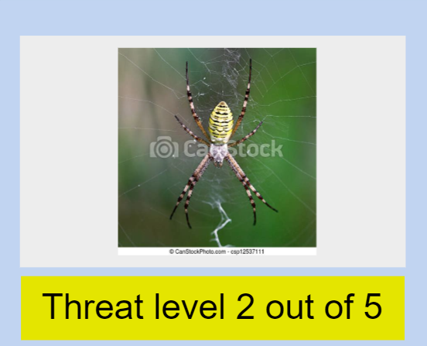
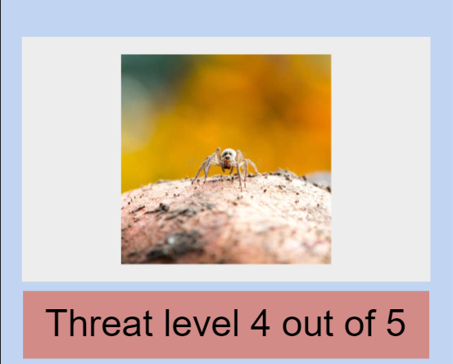
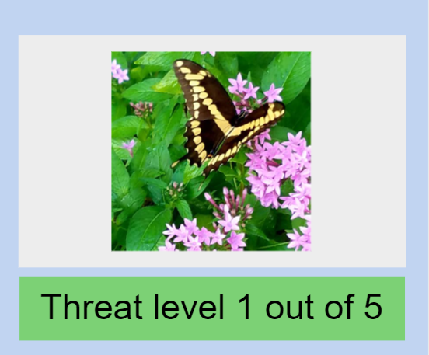
HCAI - Application Design:
Low-level design:
The spider detector application's detailed design is centered around providing a simple and intuitive user experience. The interface features clear visual tips, such as color-coded indicators, to help users assess the level of threat posed by detected spiders. User tests show that the use of special colors, such as red for high levels of threat and green for low levels of threat, improves user safety and enjoyment of using the application.
ILO Mapping: Excellent

Slide 27
HCAI - Application Design:
Wireframe Prototype:
Download wireframe:https://github.com/BredaUniversityADSAI/2022-23c-1fcmgt-reg-ai-01-DominikSzewczyk224180/blob/main/Self-study/HCAI_Wireframe_Spider%20detector_Dominik.zip
Live demo: https://pr.to/S7RP36/
Recorded demo: https://github.com/BredaUniversityADSAI/2022-23c-1fcmgt-reg-ai-01-DominikSzewczyk224180/blob/main/Self-study/Spider%20Detector%20-%20Proto.io%20player%20-%20Google%20Chrome%202023-04-05%2020-53-18.mp4
ILO Mapping: Poor, Sufficient, Good & Excellent

Slide 28
Thank you!
Any questions?

